Slide 1
CLASS PRESENTATION
SYSTEM DEVELOPMENT METHODS
CRC - Online Car Rental System
Group Members
Sandesh Subedi ‘A’ - NPI000040
Nabin Chhetri - NPI000032
Suraj Pandey - NPI000051
Sandesh Giri - NPI000041

Slide 2


MANTRA CAR RENTAL COMPANY
Providing Rental Services since 2009
Facilitating offline services
Current service felt insufficient
Objectives
To make computerized system available
To upgrade data management

Slide 3
AGILE PRINCIPLES
Customer satisfaction through early and continuous delivery of valuable software
Welcome changing requirements, even late in development
Build projects around motivated individuals
The most efficient and effective method of conveying information is to
and within a development team is face-to-face conversation
Working software is the primary measure of progress

Slide 4
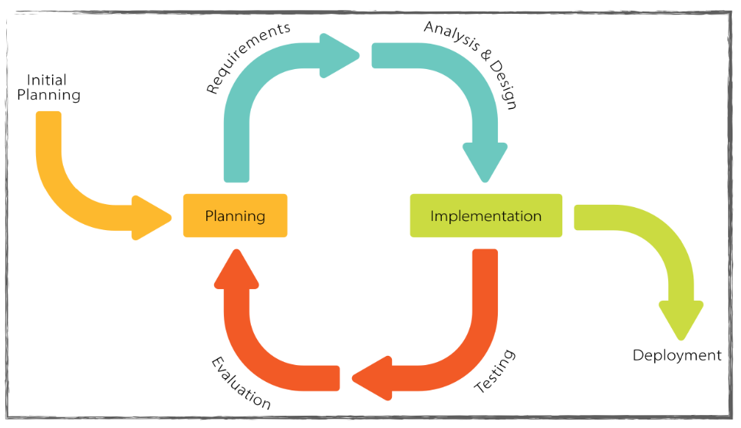
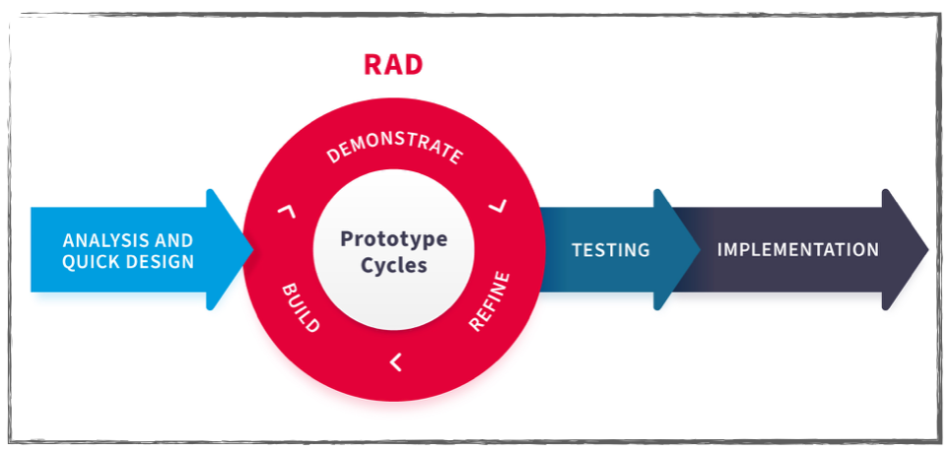
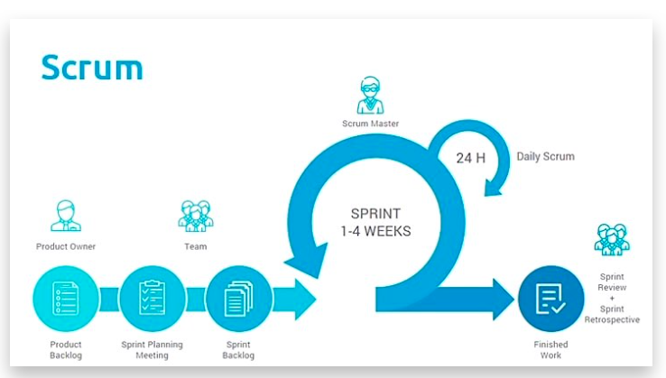
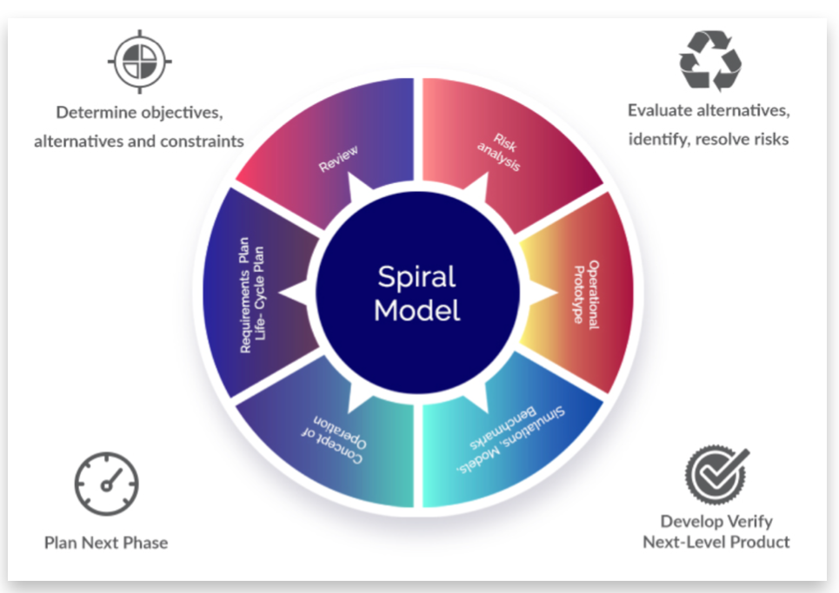
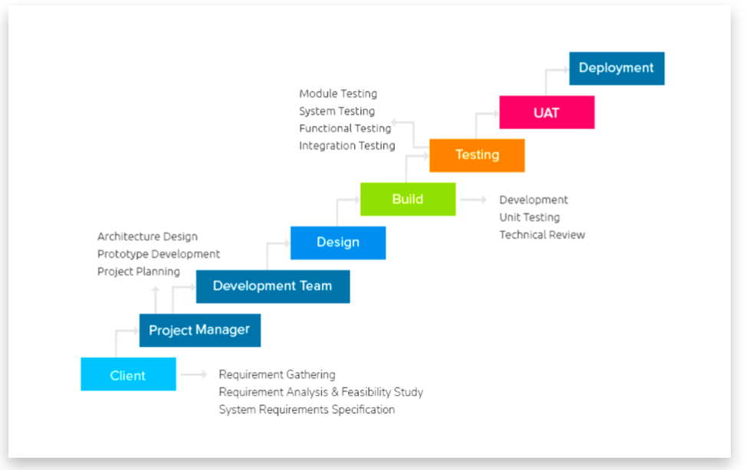
DISCUSSED METHODOLOGIES
Incremental
RAD
Scrum
Waterfall
Spiral

Slide 5
SYSTEM ANALYSIS
Our project car rental company is analyzed through SWOT analysis.
Throughout the analyzing, our team gather requirement information through
conducting interview and asked questions that we created.
After gathering information, we passed out through SWOT analysis
to rid out from the problem that faced by our client’s company.

Slide 6

SWOT Analysis
Strengths
weaknesses
opportunities
threats

Slide 7
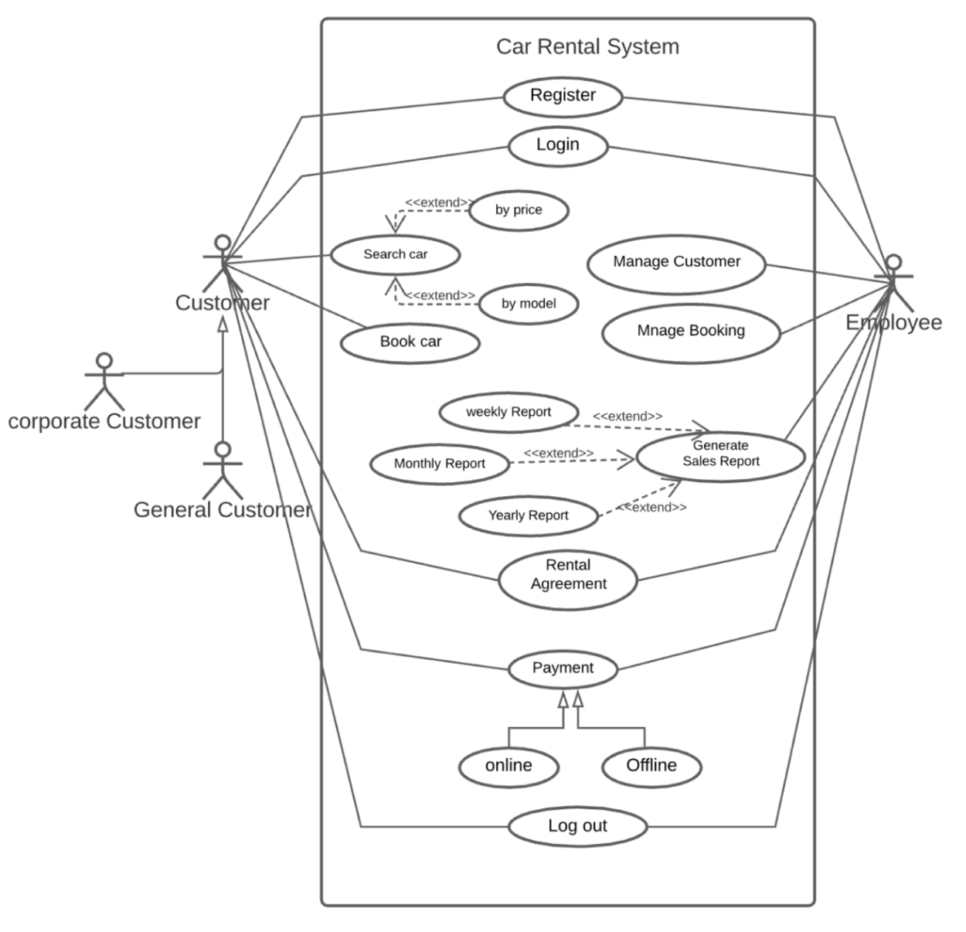
DESIGN
Use Case Diagram

Slide 8
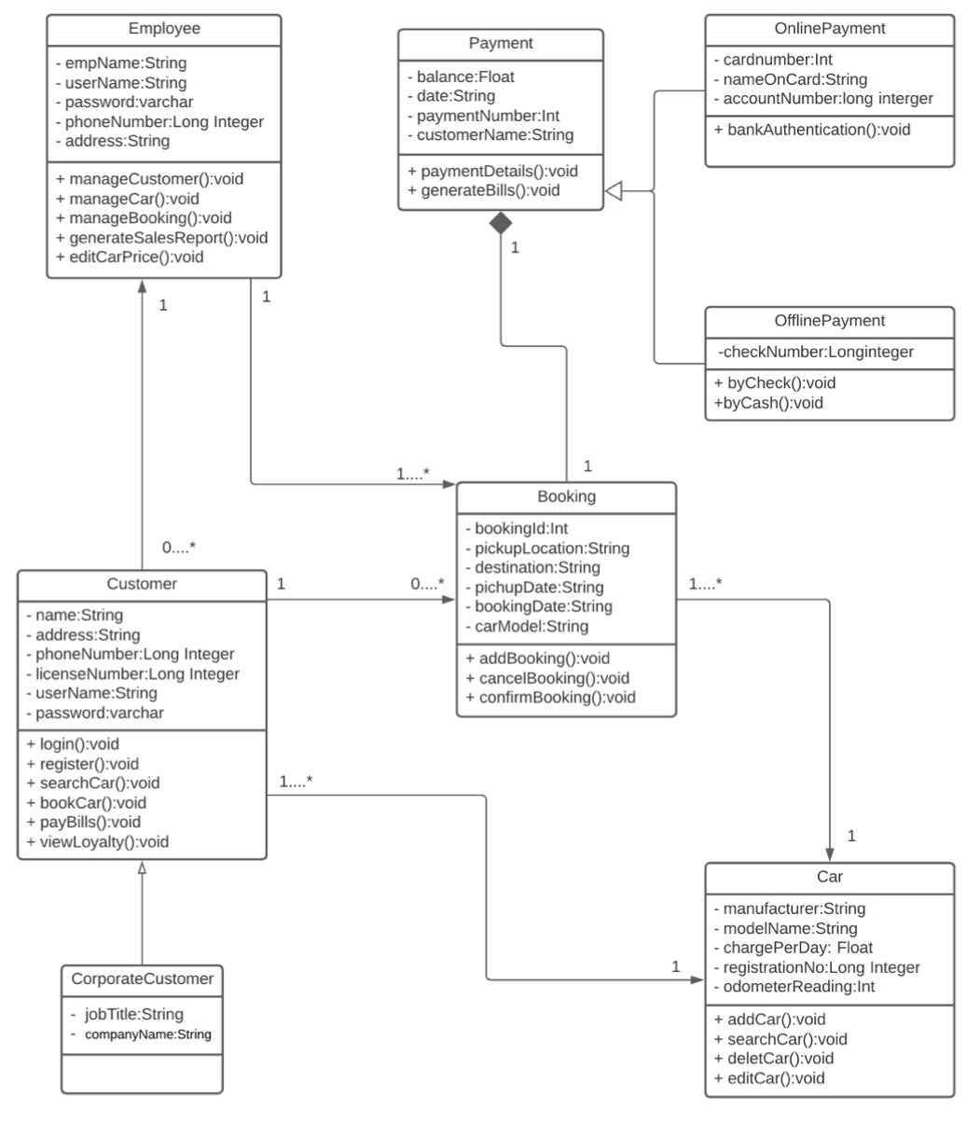
Class Diagram

Slide 9

Interface Design

Slide 10
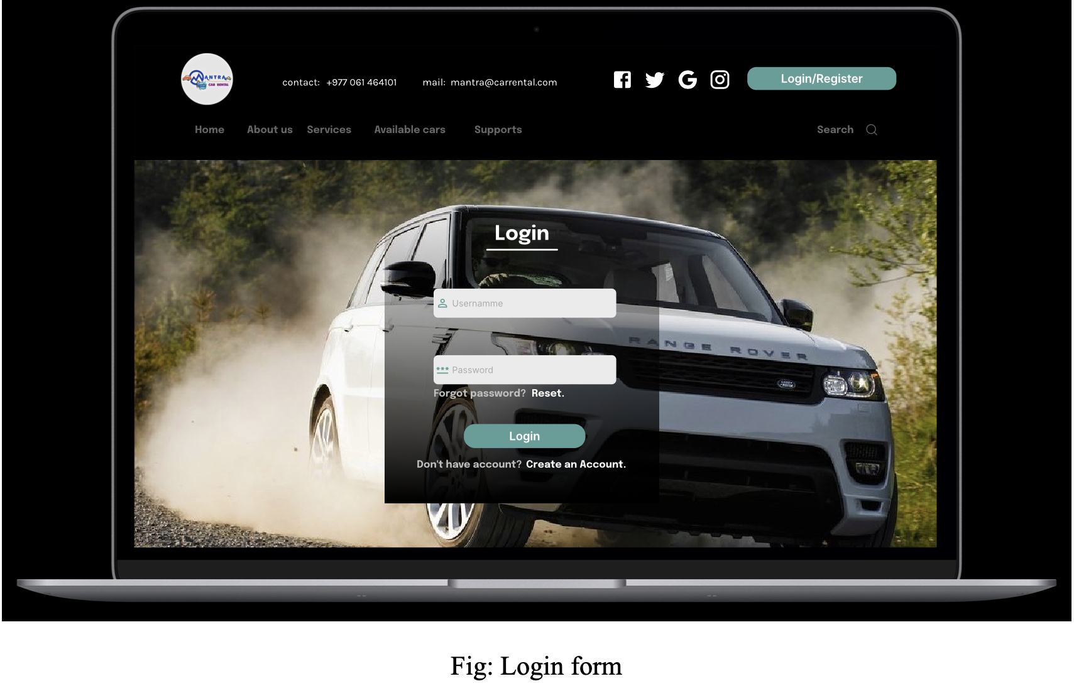

Slide 11
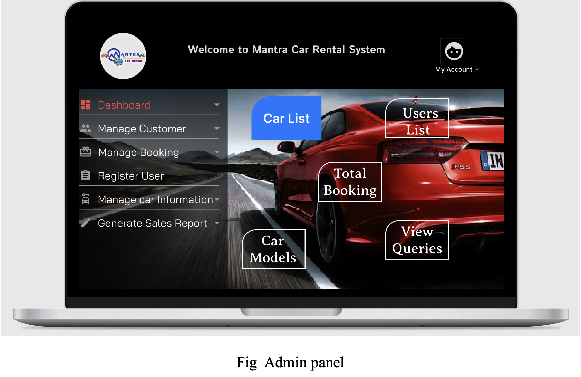

Slide 12
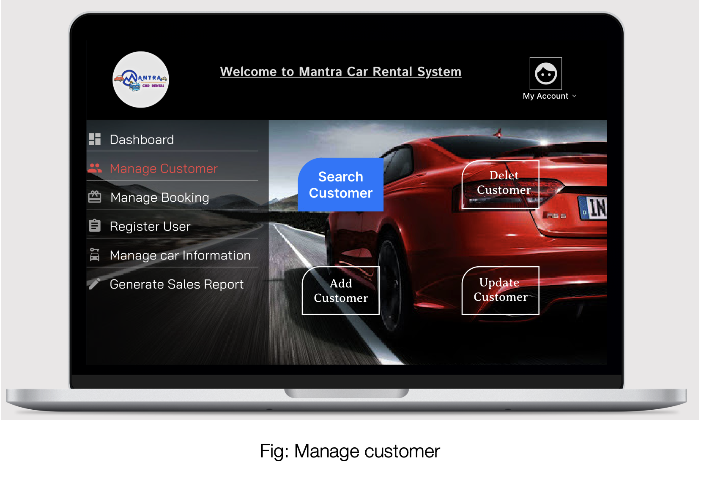

Slide 13
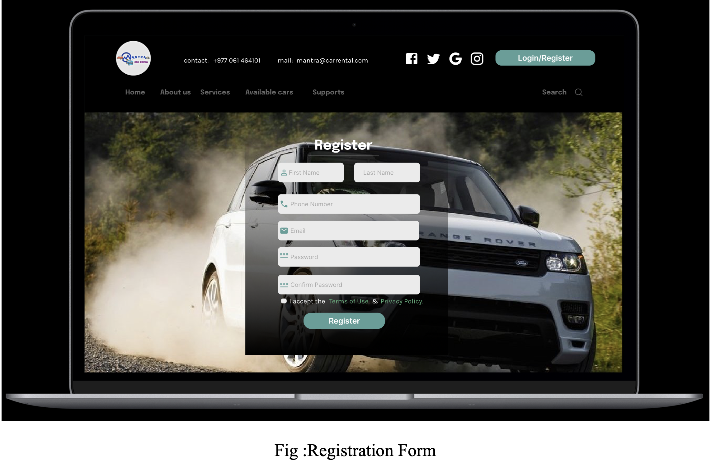

Slide 15
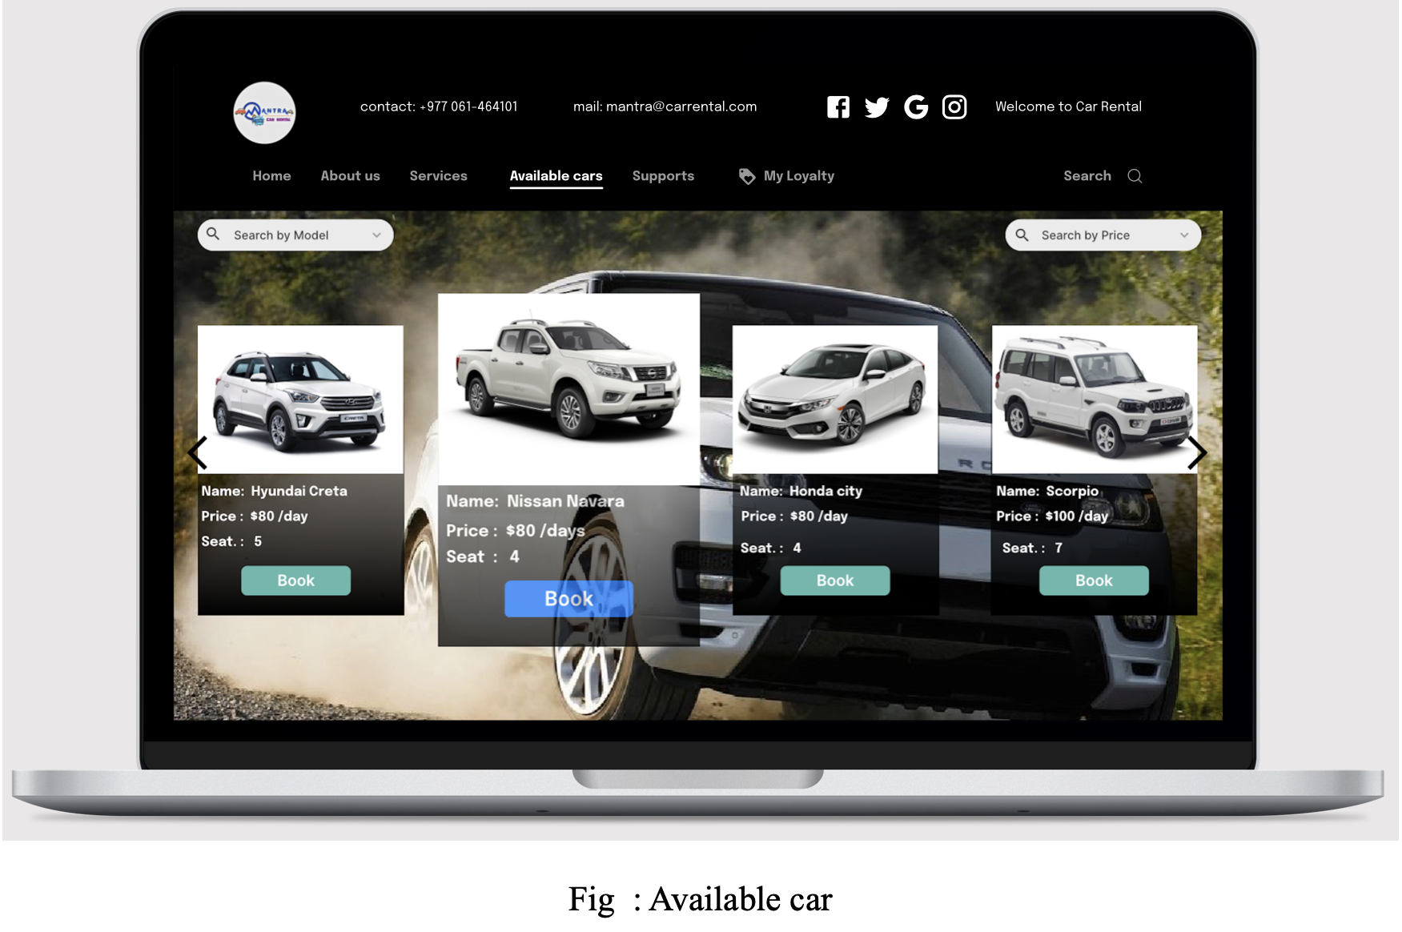

Slide 16
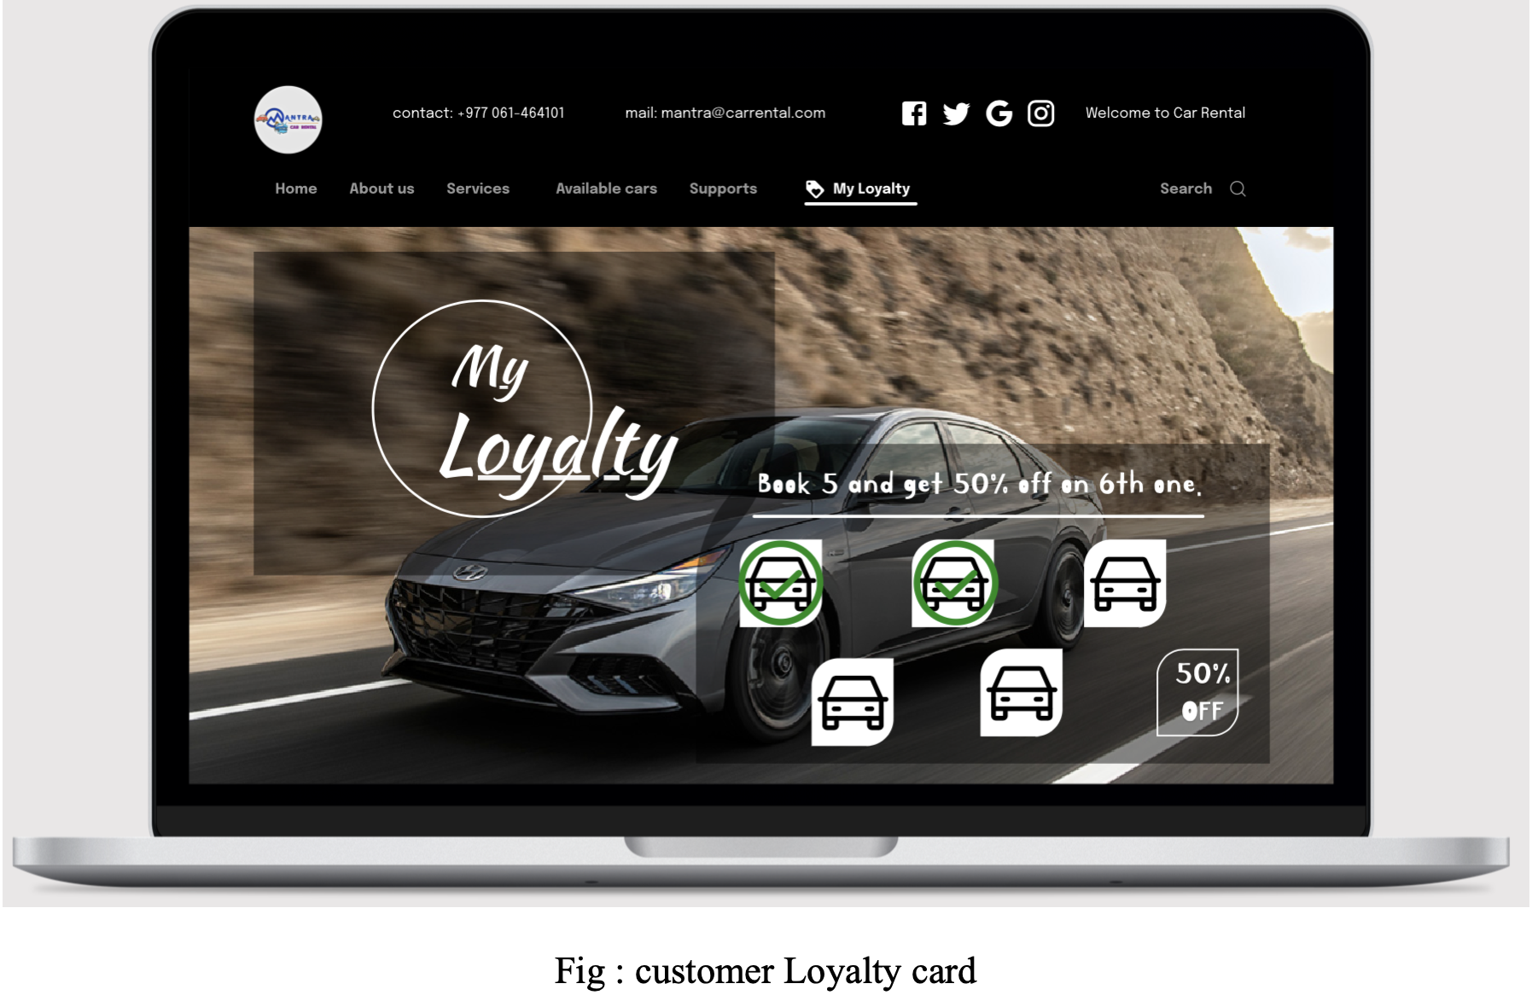

Slide 17
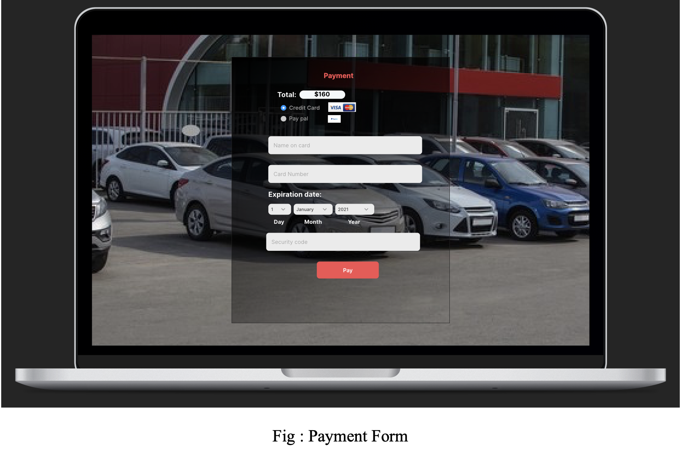

Slide 18
Implementation & Deployment
Tools Used :
HTML, CSS & Javascript
MySQL
Amazon Web Services
Adobe Dreamweaver
Framer

Slide 19
Testing Methods
Unit Testing
Integration Testing
System Testing
Deployment Method
Parallel Running System

Slide 21
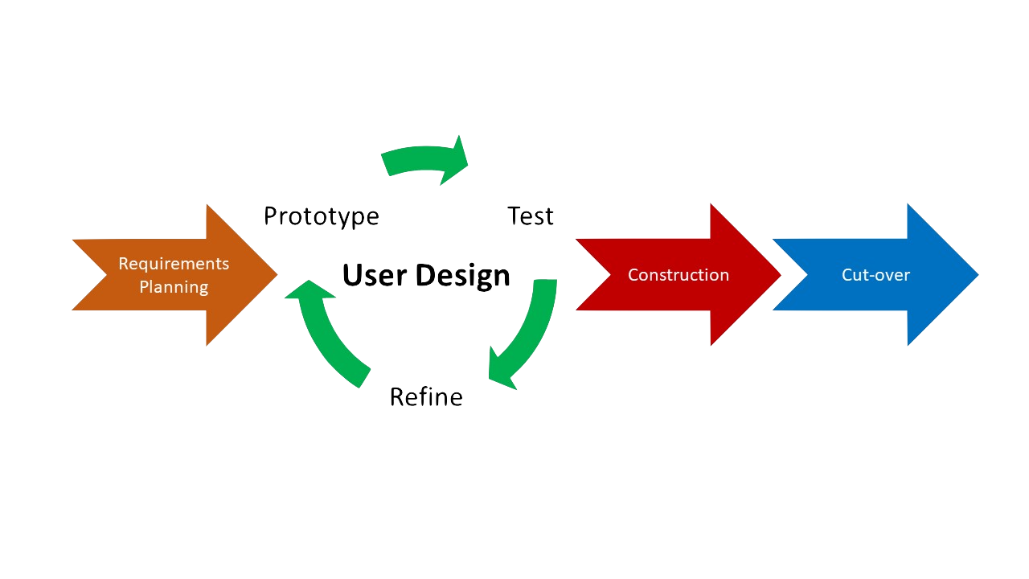
INDIVIDUAL COMPONENT
Rapid Application Development (RAD)
Requirement Planning
User Design
Construction
Cut-over

